Slide 1
PUBG Placement Prediction and parallelism
Group 11
Ke Yuan & Yifu Xu

Slide 2
Introduction
Battle Royale games have taken this world into a new gaming era. 100 players are dropped onto an island with empty-handed. They must equip themselves with the items on the ground, survive to the end. The safe zone will shrink as the game is going on. only one group could enjoy the victory.
With the arise of PLAYERUNKNOWN’S BATTLEGROUNDS in the 2017, the fashion reached the summit. It became the top3 most-selling game in Steam history. For every single player, there are questions like how to get a better placement. What will influence our placement most? And is there a strategy that always works? Data can answer these questions. Here is a competition in Kaggle for predicting placement according players’ performance in over 65000 games. As big fans of Battle Royale, it will be a pleasure to analysis these data and find a way guiding us for a better placement.

Slide 3
Description of Dataset
In a PUBG game, there are 100 players, but this is no guarantee. In game, players can pick up weapons, shoot enemies, walk or drive to avoid the gas, also can swim sometime, revive your teammates if they are down but not eliminated. All these data are formatted by the “The Blue Circle” official API. Every row presents a player. We are supposed to predict the final “winPlacePerc”. This attribute is distributed from 0(last place) to 1(first place). It is scaled according to your placement and the number of groups in total.

Slide 4
Methodology
There are two different algorithms to solve this problem in most common solutions. One is LightGBM. As the most used algorithm in the Kaggle competition, it sure holds its ground once Microsoft team open-sourced it when compared to other Gradient Boosting algorithms such as XGBoost. It has many advantages:
Faster training and higher efficiency
Lower memory usage
Better accuracy
Support of parallel and GPU learning
Capable of handling large-scale data.
Another is CatBoost. It is also use gradient boosting on decision tree and is available as an open source library.

Slide 5
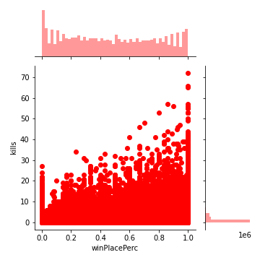
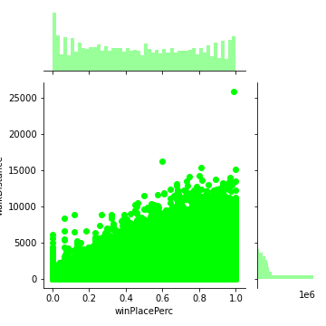
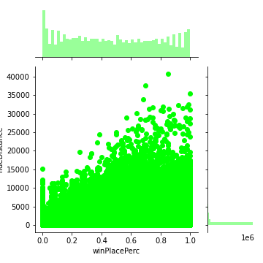
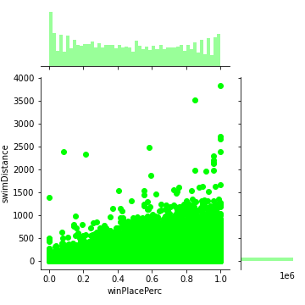
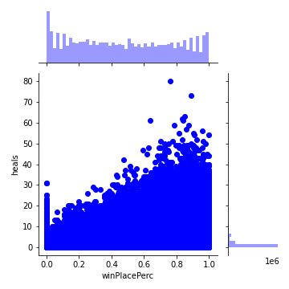
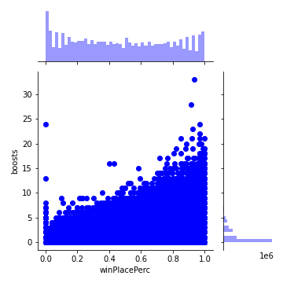
EDA

Slide 6
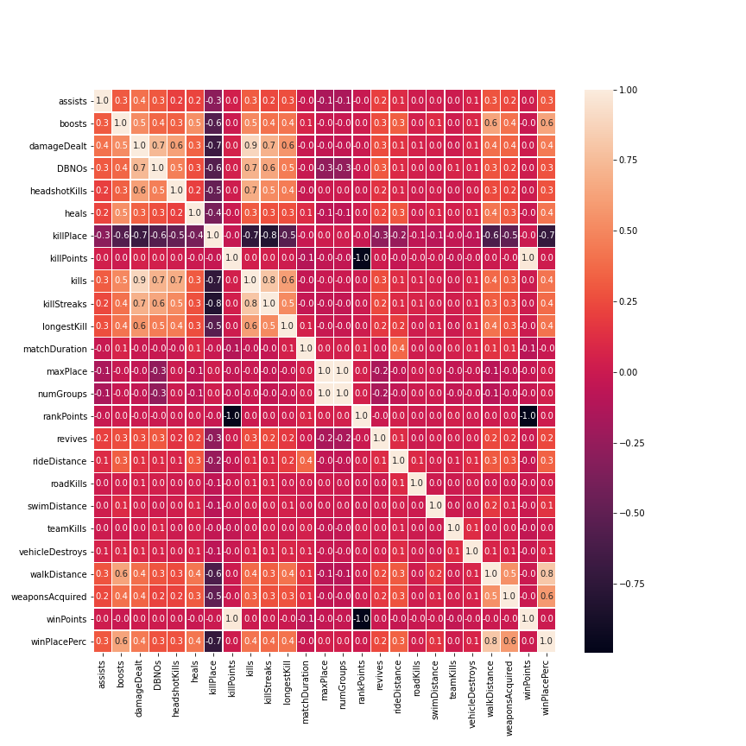
Heat map

Slide 7
Feature engineering
rank as percent
new features
drop features

Slide 8
Parameters tuning
Tune Parameters for the Leaf-wise (Best-first) Tree
For Faster Speed
For Better Accuracy
Deal with Over-fitting
adj_params = {'n_estimators': range(100, 400, 10),
'max_depth': range(5, 15, 2),
'num_leaves': range(10,100,10),
'min_child_weight': range(3, 20, 2),
'min_child_samples': range(10, 30),
'reg_lambda': [0,0.001,0.01,0.05,0.08,0.1,0.3,0.5],
'reg_alpha': [0,0.001,0.01,0.05,0.08,0.1,0.3,0.5],
'feature_fraction':[0.5,0.6,0.7,0.8,0.9],
'bagging_fraction':[0.6,0.7,0.8,0.9,1.0]
}

Slide 9
Train and Predict
In the last stage, we set the learning rate to 0.1 for faster convergence. Now we get the best parameters and save them in a file for further usage. But when it comes to predicting, we need a new model which learning rate set to 0.01 for better accuracy. This will be our final model. It will be saved as a file, too.
After this training, we can predict our target “winPlacePerc” on the test data set now. At the first stage, we split the 10% of the data as the test data. Only 90% of the data participate the parameters tuning and training. But the whole dataset need be preprocessed in the same way. It is essential to ensure the data consistency. The metric used to evaluate our model is MSE (Mean Squared Error).
This is also the metric of this competition to evaluate all the teams.

Slide 10
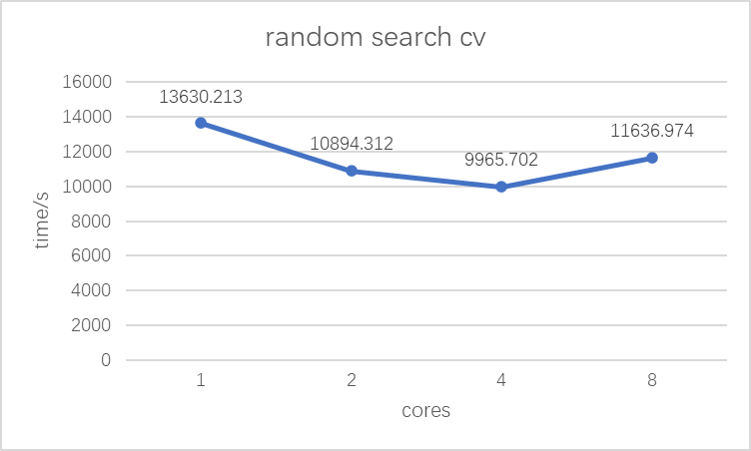
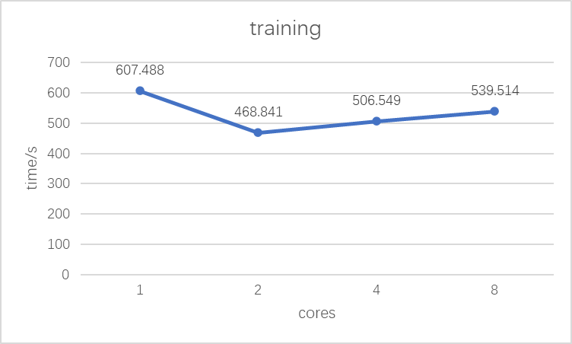
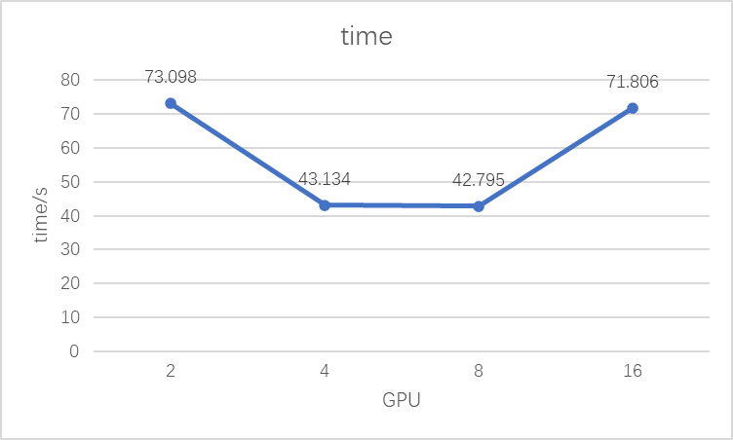
Parallel

Slide 11
Results and Analysis

Slide 12
improvements
Parallel
GPU
Dataset
feature engineering
Iteration
edge case

Slide 13
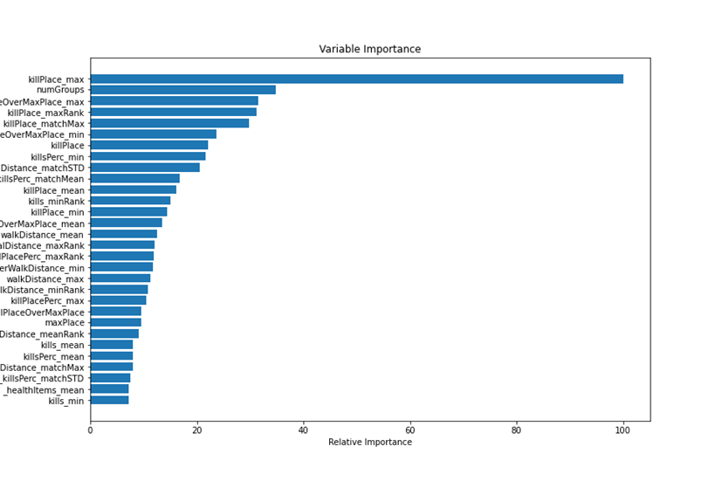
Conclusion

Slide 14
Conclusioin
For lightGBM, the best number of CPU is 4. Parallelism on CPU can accelerate parameter tuning process and training process.
For CatBoost, the best number of GPU is 8. Parallelism on GPU can accelerate parameter tuning process and training process.

Slide 15
Reference
Kaggle notebooks:
https://www.kaggle.com/deffro/eda-is-fun
https://www.kaggle.com/rejasupotaro/effective-feature-engineering
https://www.kaggle.com/plasticgrammer/pubg-finish-placement-prediction-playground
documentation
https://lightgbm.readthedocs.io/en/latest/
https://catboost.ai/docs/concepts/about.html
forum:
https://zhuanlan.zhihu.com/p/139453884
https://datascience.stackexchange.com/questions/63129/gridsearchcv-vs-randomsearchcv-and-how-it-works

Slide 16
Thank you

